Slide 1
Predict Sparkify Customer Churn
A Data Analytics Project for Customer Churn Prediction
Group 9:
Aashrith Sangani
Ayan Basu
Kumar Shivam
Satyaraj Reddy Nandi

Slide 2
Agenda
Problem Statement
Product Position Statement
Project Components
Platform
Source of Data
Explore Data
Clean and Transform Data
Model Data
Evaluate Model Accuracy
Visualize Results
Conclusion
Future Work

Slide 3
Problem Statement
The problem of | customer engagement, retention and churn
affects | the business (Sparkify) globally
the impact which is | potential loss of business worth millions in revenue
a successful solution would be | to classify vulnerable users before they leave, so that the company can offer them discounts and incentives. Acquiring new customers are generally more expensive than upgrading and satisfying existing customers
Notes:
Why Churn is Important?
Companies make revenue from their customers. This is the basics of the businesses. If one company is losing their customers whatever the reasons, revenues will be decreased. Churn reasons can be customer experience problems, high prices, low quality and so on. It depends on the business area as well.
In this project we have tried to understand the customer behaviors and identify the customers of Sparkify, a fictional digital music streaming provider, who will cancel their subscription whether in free or paid tier.

Slide 4
Product Position Statement
For | the companies
Who | wish to retain the customers
Customer Churn Prediction | is a churn prediction tool
That | provides precise customer churn prediction based on the customer logs present with the companies
Unlike | other tools which does not take up several critical variables
Our product | uses customers demographics, their behaviour, app events (logging in, adding a friend) and so on

Slide 5
Platform
Databricks.com (Community edition)

Slide 6
Source of Data
Provided by Udacity
6GB, medium size dataset is used in this project
https://drive.google.com/file/d/16EtjE2Fmo0j8aRPUbIacJT0B-47BIQ63/view?usp=sharing

Slide 7
Explore the Data
18 Features:
Artist — which has 17656 unique artists in it
Auth — authentication level
firstName — first name of the user
gender — gender of the user
itemInSession — log count in a session
length — length of the song played (in seconds)
location — user location
method — GET or PUT HTTP request method
page — page with which user is currently interacting
registration — timestamp of user’s registration
sessionId — session of the log
Notes:
With 543k rows there are 18 columns which are representing customers demographics, app events and so on. As in every company, Sparkify has churn problems and needs to control the churn action. According to the data provided to us the churn rate is 20% in the Sparkify.
Sparkify has two types of customers: Free Tier and Paid Tier. For example company can offer Paid Tier Subscription for 1 month to the Free Tier churner customers with no charge or company can offer promotion to the Paid Customers. These kind of actions provide increasing of customer satisfaction willingly or unwillingly also prevent the customers churn actions.

Slide 8
Explore the Data
song — song played by user
status — HTTP code of status — 200, 307, 404
ts — timestamp of a given interaction
userAgent — what user used as streaming service (Mac/Linux/Windows/iPhone/etc.)
userId — unique id of the user
Rows: 543k rows

Slide 9
Clean and Transform Data
StringIndexing – using StringIndexer()
Encoding a string column of labels to a column of label indices.
On features – “Artist”, “Songs”
OneHotEncoding – using OneHotEncoder()
Encoding the features – “OS” (‘iOS, Linux, Ubuntu, Mac OS X, Windows’), Browser (‘Firefox, Safari, Mobile Safari, IE, Chrome’)

Slide 10
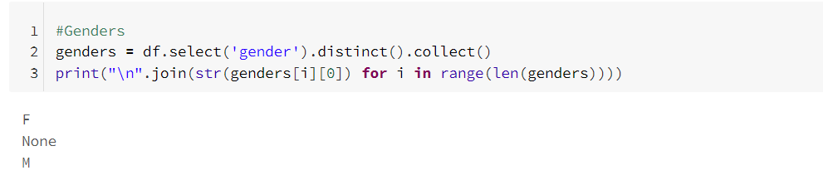
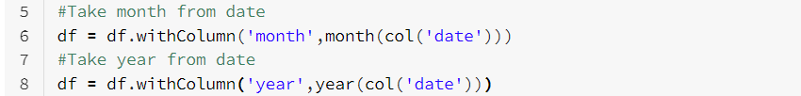
Clean and Transform Data
Dropna – dropping the unnecessary columns from the dataset.
Extracting the month and year from the Date –

Slide 11
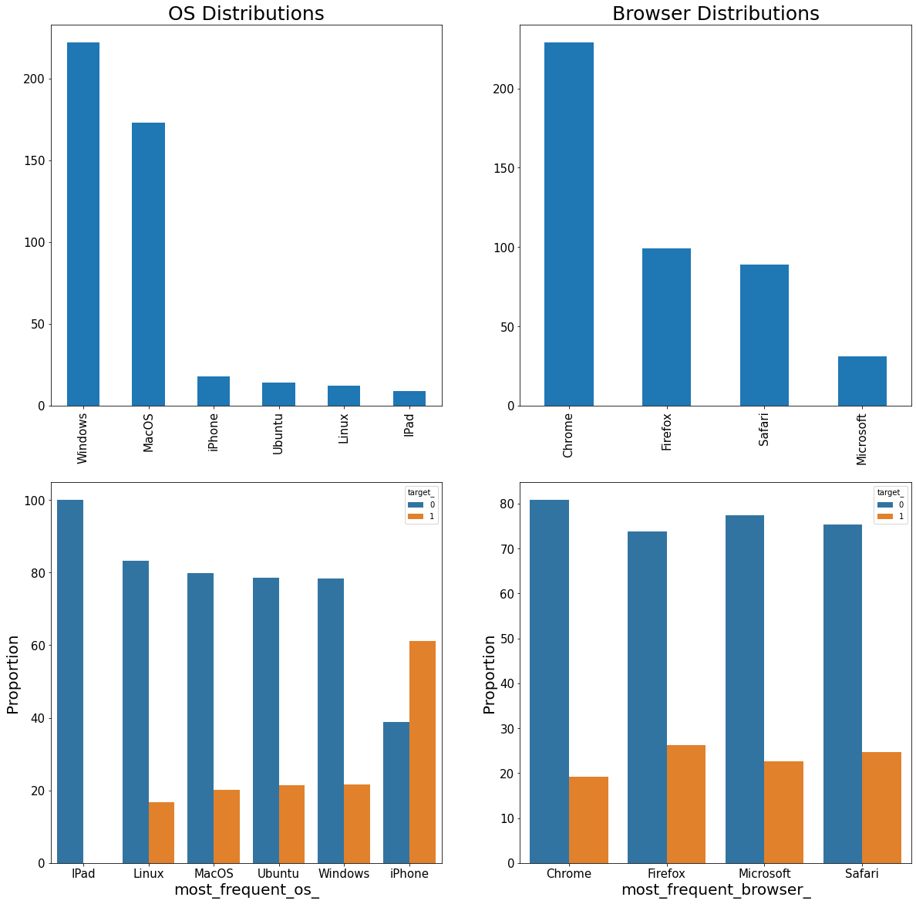
OS & Browser Distribution
Most of users opt for Windows as the OS and most of users use Chrome web browser.
iPad has 0 churn rate but proportion of iPad users are very low.
Linux, MacOs, Ubuntu and Windows users has nearly 20% churn rate but iPhone users 60% churn rate.
Maybe there is a problem with user experience. Users who are using Firefox web browser churn rate is nearly 30%. Both OS and Browser attributes can be good predictor for churn.

Slide 12
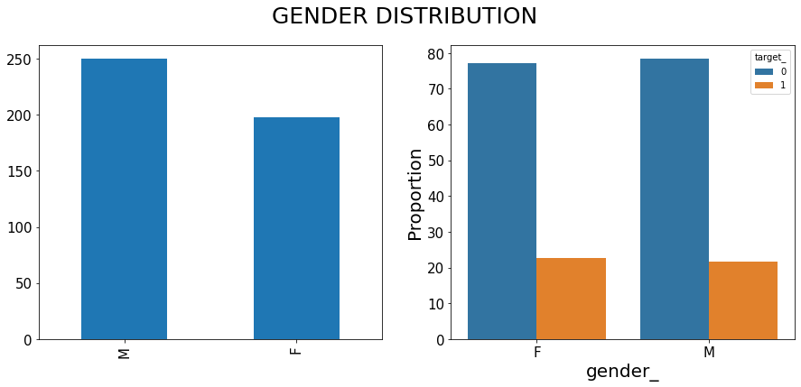
GENDER DISTRIBUTION
There is no significant churn rate difference in Gender.

Slide 13
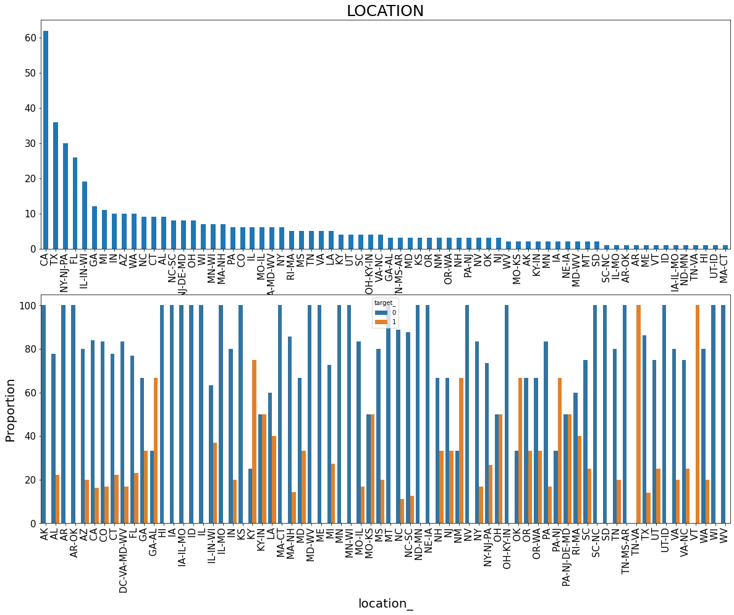
LOCATION
Location can be good estimator because some location has nearly 100% churn rate.
So, let’s keep this attribute in the model data.

Slide 14
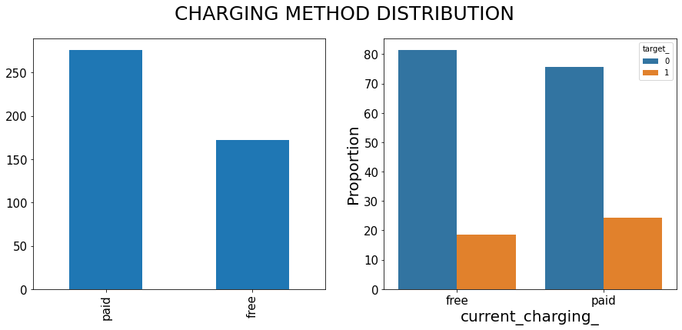
FREE VS PAID CUSTOMERS DISTRIBUTION
It is interesting that both paid and free customers have nearly same churn rate. We expected that paid customers have high churn rate, but it is not true in this case.

Slide 15
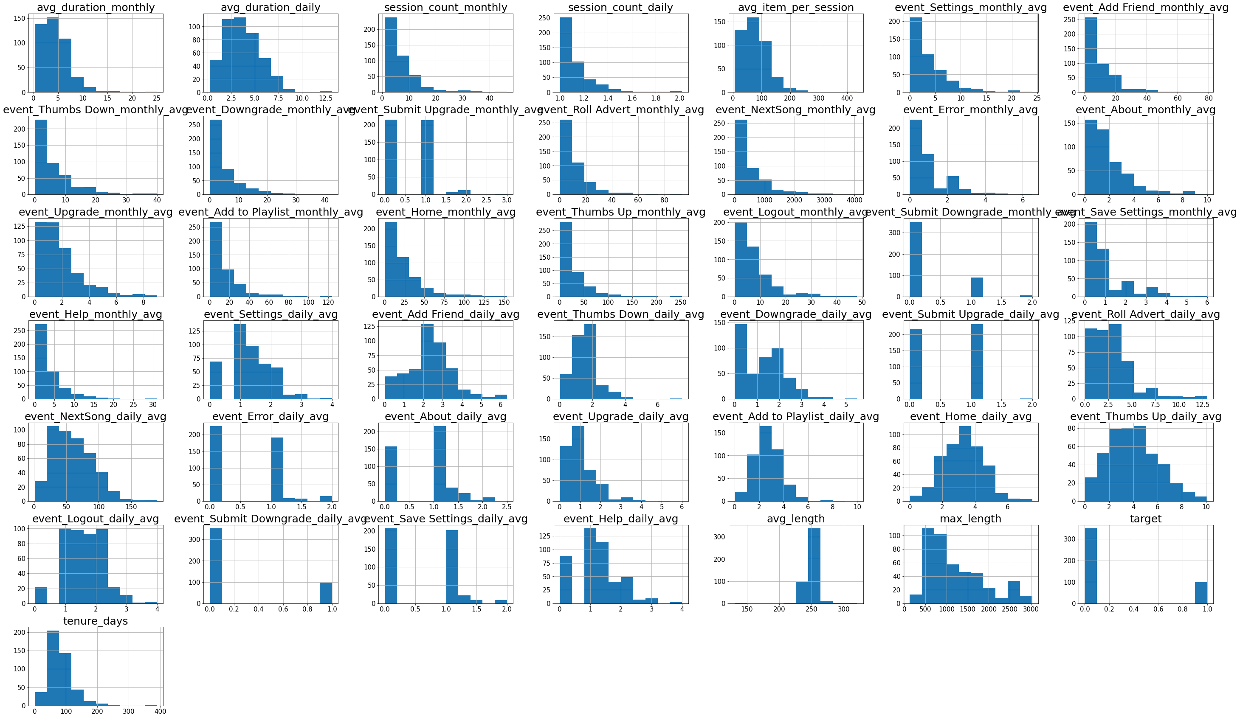
LASTLY, LET’S HAVE A LOOK AT THE VARIABLES BEFORE MODELLING THE DATA!
The graph beside shows the distribution of all the variables in the dataset. Some of them are highly skewed and we had to use ML algorithms which are not sensitive to data skewness, starting with RandomForest.

Slide 16
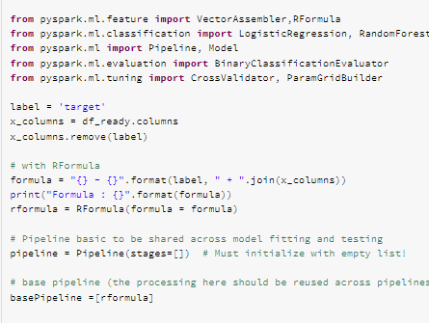
Model Data
Importing the required libraries to build the base pipeline and build the appropriate models.

Slide 17
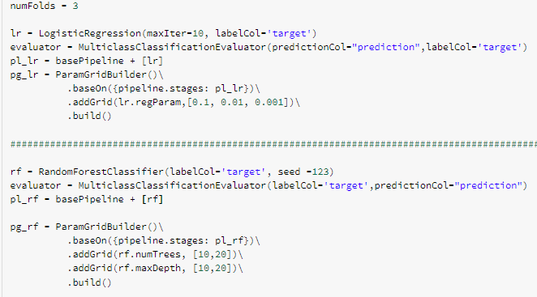
Model Data
Setting the right parameters with the input and output columns for:
Random Forest Classifier
Logistic Regression

Slide 18
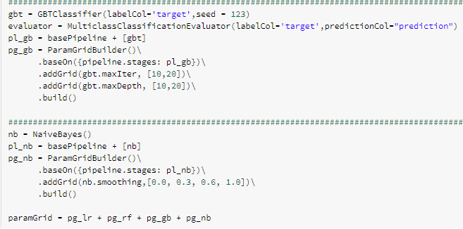
Model Data
Setting the right parameters with the input and output columns for:
GBT Classifier
Naïve Bayes

Slide 19
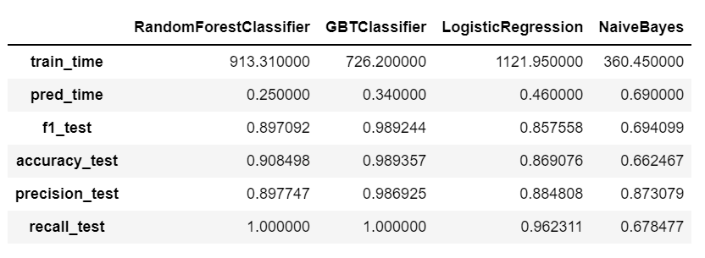
Model Results
Train Time: NaivesBayes is the Best
F1 Score: GBTClassifier is the Best
Accuracy Score: GBTClassifier is the Best
Precision: GBTClassifier is slightly higher than the Random Forest
Recall: Random Forest as well GBTClassifier produce the same recall time.
When we look at the F1 Score, GBTClassifier beats the others. On the other hand, recall of both RandomForest and GBTClassifier is 1. It means that both the models caught all churners correctly.

Slide 20
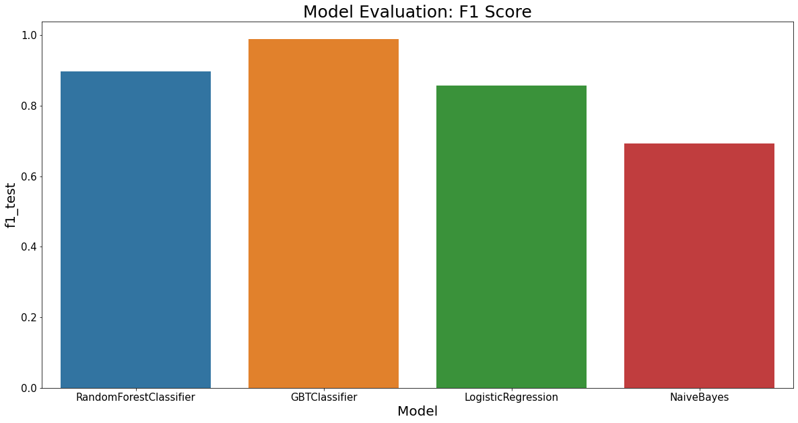
Visualize Model Evaluation Results

Slide 21
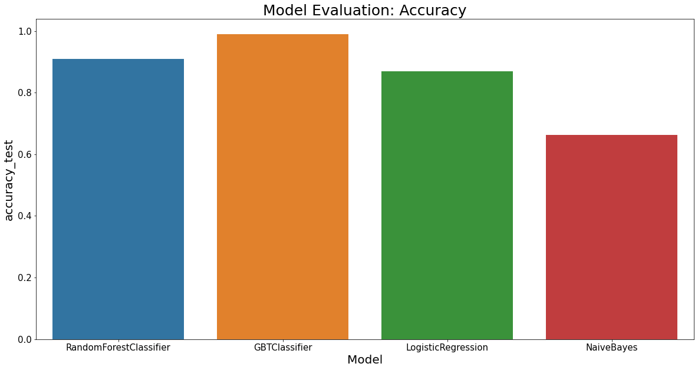
Visualize Model Evaluation Results

Slide 22
Conclusion
GBTClassifier Churn Prediction model can help Sparkify to identify approx. 98% of the users who would churn.
F1 Score: ~98.92%
Accuracy: ~98.93%
The company can use special promotions or other measures to prevent them from cancelling the service.

Slide 23
Future Work
Try other models such as XGBoost, LightGBM to obtain more precise results.
Ensembling approaches to train several classifiers and combining their predictions.

Slide 24
Thank You

